Slide 1
Internet of Things Database
What is Internet of Things?
The Internet of Things (IoT) is a network of smart devices that use sensors, software, and internet connection to collect data and then connect to the internet to share these data.
Μάθημα ΕΠΛ421: Προγραμματισμός Συστημάτων Χειμερινό Εξάμηνο 2024
Smart home devices
Wearables
RFID Clothing
Complex industrial machinery
Transportation systems
Δήμητρα Παφίτου

Slide 2
Content
Internet of Things
Internet of Things Database
Apache IoTDB
Query Language
Setup
CREATE
INSERT
Queries
Users
Functions
Notes:
ΑΗ
Να δούμε λίγο συνοπτικά τα περιεχόμενα της παρουσίασης μας. Αρχικά θα ΄δόυμε

Slide 3
What is Internet of Things?
The Internet of Things (IoT) is a network of smart devices that use sensors, software, and internet connection to collect data and then connect to the internet to share these data.
Smart home devices
Wearables
RFID Clothing
Complex industrial machinery
Transportation systems

Slide 4
What is the IoT database?
Specialized storage system for data collected by IoT devices
Handles large amount of data
Real-time and time-based data analysis

Slide 5
Apache IoTDB
High-throughput read and write
Efficient directory structure
Rich queries semantics
Low cost on hardware
Flexible deployment
Intense Integration with Open-Source Ecosystem

Slide 6
IoTDB Query Language
SQL-Like queries
4 Major parts
Schema statement: Management of Schema, Create, Delete
Data Management statement: Insertion, delete, select
Database Management statement: Database management and authentication, Create User, Create Role
Functions: Count, FirstValue

Slide 7
Steps for Setup
git clone https://github.com/apache/iotdb.git
git checkout rel/1.0
It’s best to change into a release version, the command above downloads the developer version
Go to this directory /iotdb/distribution/target
unzip apache-iotdb-1.0.2-SNAPSHOT-datanode-bin.zip
unzip apache-iotdb-1.0.2-SNAPSHOT-confignode-bin.zip
Now we need to start the confignode and then the datanode (each are located in different directories). These are running while the DB is running.
Sudo ./start-confignode.sh
Sudo ./start-datanode.sh
Start the db. Make sure you have enough space in disk to run queries
./start-cli.sh -h 127.0.0.1 -p 6667 -u root -pw root

Slide 8
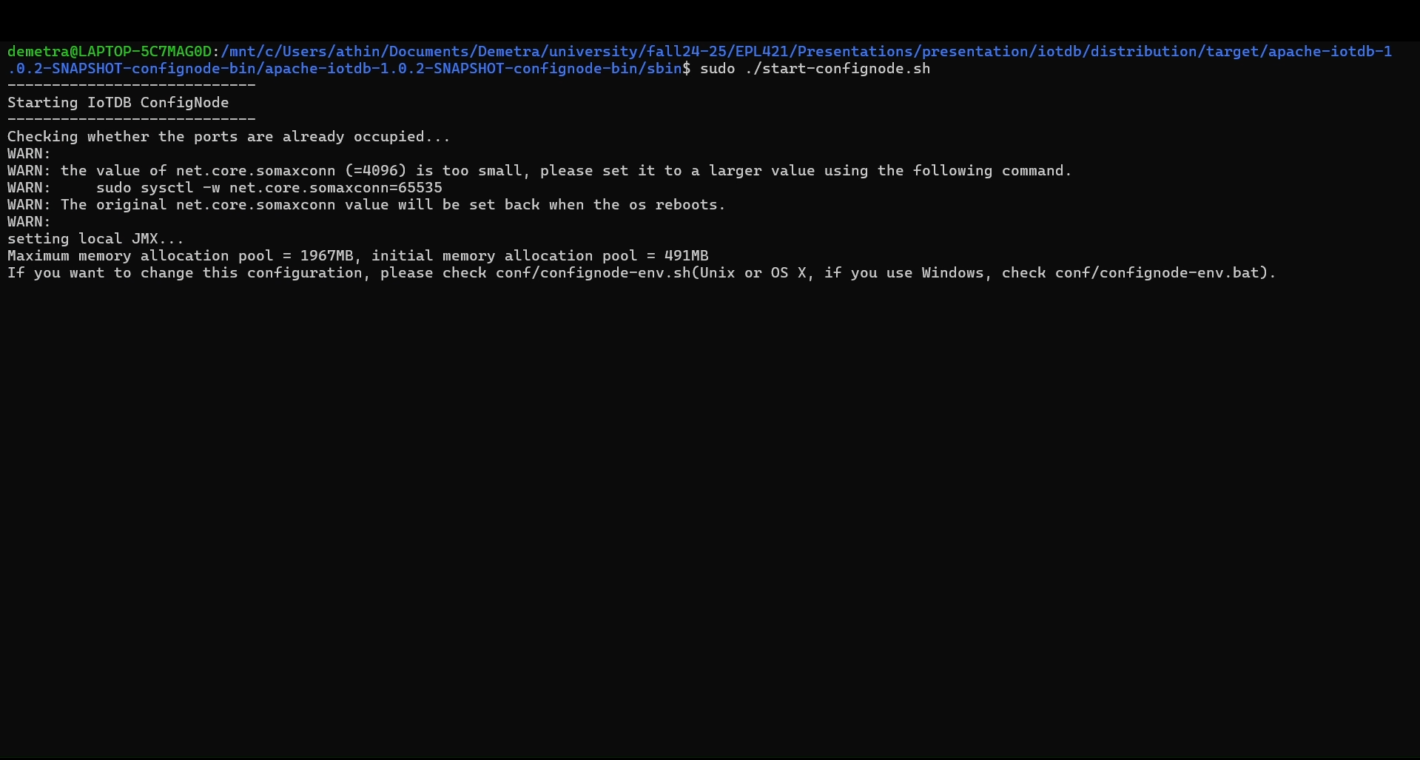

Slide 9
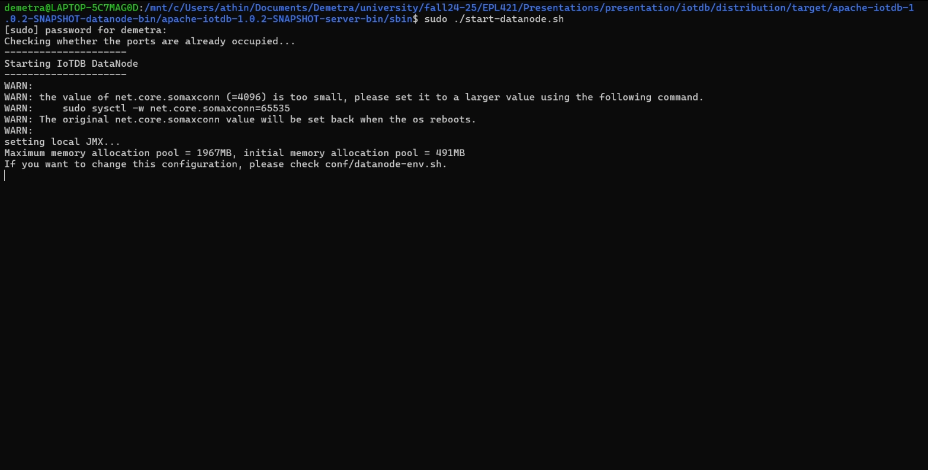

Slide 10
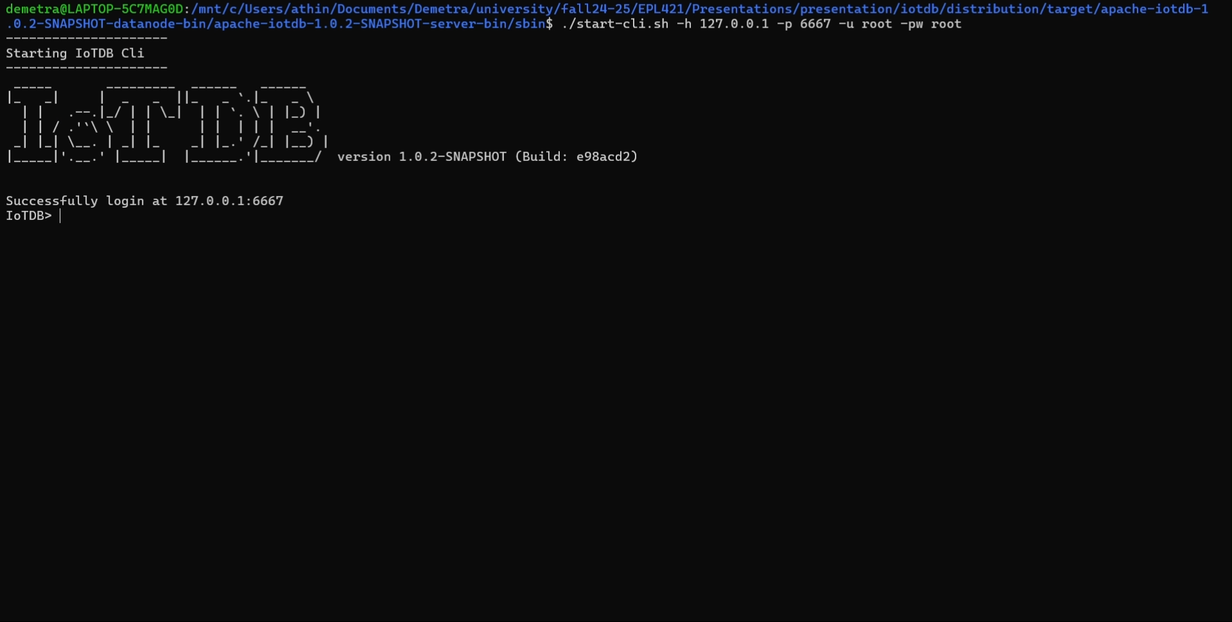

Slide 11
Create a Database
Let’s implement a City Monitoring System!
The database will monitor a futuristic city where everything can be done with smart devices. IoTDB acts as the central database that stores, organizes, and helps analyze all the time-series data generated by these devices. The goal of the system is to improve living conditions in various areas.
CREATE DATABASE root.smart_city;

Slide 12
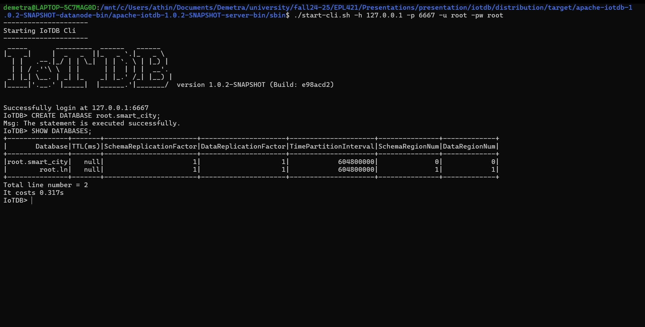

Slide 13
Entities in Database
For this scenario, there are these entities with their respective attributes:
Streetlights
Status (on/off)
Brightness (percentage)
Energy_usage(kWh)
Air Quality
Pm25 (air particulate level)
Temperature (ºC)
humidity (percentage)
Traffic Sensors
Vehicle_count (vehicles/minute)
Average_speed (km/h)
Water Quality Sensors
pH_level (0-14)
Turbidity (NTU)
Temperature (ºC)

Slide 14
CREATE command
CREATE TIMESERIES root.smart_city.streetlight001.status WITH DATATYPE=BOOLEAN, ENCODING=PLAIN;
TIMESERIES: Single column used in IOTDB
root.smart_city: Path of database
streetlight001: Specific entity
status: Specific attribute
DATATYPE=BOOLEAN: Kind of value TIMESERIES stores.
ENCODING=PLAIN: Encoding schemes for data storing
We work similarly for the other entities and their attributes.
Note: The IoTDB does not support traditional SQL tables. Each object should be initialized separately.

Slide 15
Encoding schemes
Encoding | Description | Best for
PLAIN | Stores values directly without encoding | Data with no obvious patterns
RLE | Compresses repeated values efficiently | Data with repeated or constant values
GORILLA | A time-series-specific encoding based on Facebook’s Gorilla paper, optimized for numeric data | Numeric data with small deltas
TS_2DIFF | Stores only the difference between consecutive values, with good compression | Slowly changing numeric data
BITMAP | Encoding binary data efficiently | Boolean or binary data
DICTIONARY | Assigns unique codes to repeated string values | Strings with repeated patterns

Slide 16
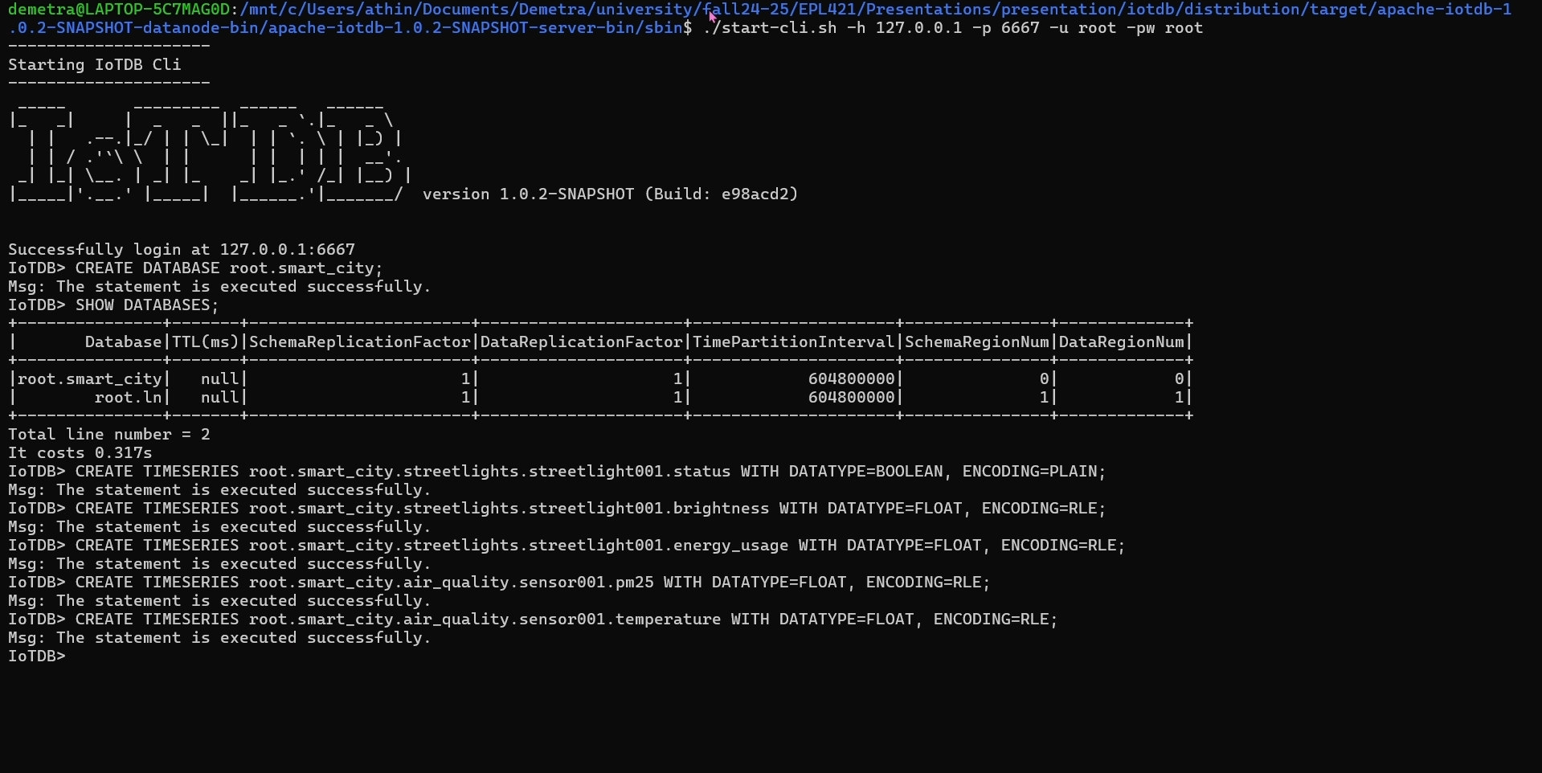

Slide 17
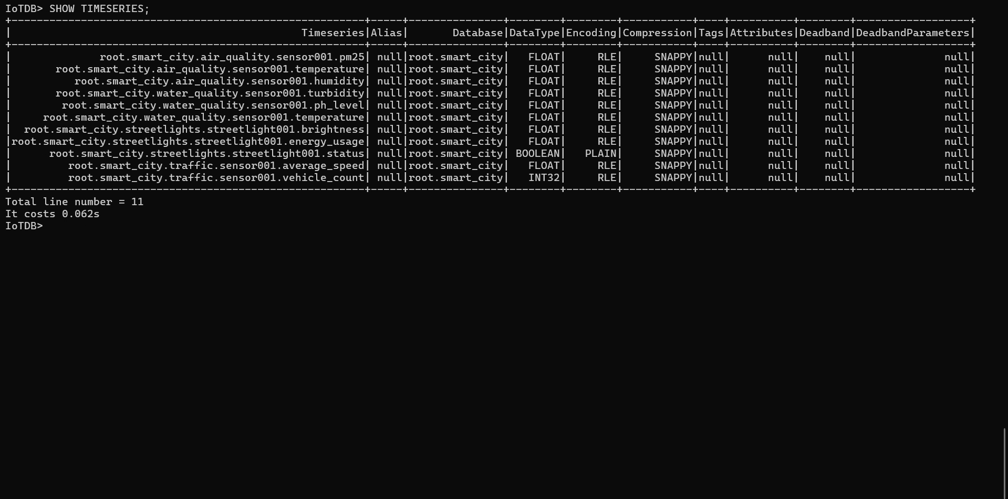

Slide 18
CREATE
-- Streetlights
CREATE TIMESERIES root.smart_city.streetlights.streetlight001.status WITH DATATYPE=BOOLEAN, ENCODING=PLAIN;
CREATE TIMESERIES root.smart_city.streetlights.streetlight001.brightness WITH DATATYPE=FLOAT, ENCODING=RLE;
CREATE TIMESERIES root.smart_city.streetlights.streetlight001.energy_usage WITH DATATYPE=FLOAT, ENCODING=RLE;
-- Air Quality Sensors
CREATE TIMESERIES root.smart_city.air_quality.sensor001.pm25 WITH DATATYPE=FLOAT, ENCODING=RLE;
CREATE TIMESERIES root.smart_city.air_quality.sensor001.pm10 WITH DATATYPE=FLOAT, ENCODING=RLE;
CREATE TIMESERIES root.smart_city.air_quality.sensor001.temperature WITH DATATYPE=FLOAT, ENCODING=RLE;
-- Traffic Cameras
CREATE TIMESERIES root.smart_city.traffic.sensor001.vehicle_count WITH DATATYPE=INT32, ENCODING=RLE;
CREATE TIMESERIES root.smart_city.traffic.sensor001.average_speed WITH DATATYPE=FLOAT, ENCODING=RLE;
-- Water Quality Sensors
CREATE TIMESERIES root.smart_city.water_quality.sensor001.pH_level WITH DATATYPE=FLOAT, ENCODING=RLE;
CREATE TIMESERIES root.smart_city.water_quality.sensor001.turbidity WITH DATATYPE=FLOAT, ENCODING=RLE;
CREATE TIMESERIES root.smart_city.water_quality.sensor001.temperature WITH DATATYPE=FLOAT, ENCODING=RLE;

Slide 19
CREATE Script
To add more sensors of each entity, a script can be created.
File: create_timeseries.sql with the below script
--Second Sensor--
CREATE TIMESERIES root.smart_city.streetlights.streetlight002.status WITH DATATYPE=BOOLEAN, ENCODING=PLAIN;
CREATE TIMESERIES root.smart_city.streetlights.streetlight002.brightness WITH DATATYPE=FLOAT, ENCODING=RLE;
CREATE TIMESERIES root.smart_city.streetlights.streetlight002.energy_usage WITH DATATYPE=FLOAT, ENCODING=RLE;
--Third Sensor--
CREATE TIMESERIES root.smart_city.streetlights.streetlight003.status WITH DATATYPE=BOOLEAN, ENCODING=PLAIN;
CREATE TIMESERIES root.smart_city.streetlights.streetlight003.brightness WITH DATATYPE=FLOAT, ENCODING=RLE;
CREATE TIMESERIES root.smart_city.streetlights.streetlight003.energy_usage WITH DATATYPE=FLOAT, ENCODING=RLE;
--Repeat for others—
Now when starting the client, run: $./sbin/start-cli.sh -h 127.0.0.1 -p 6667 -u root -pw root -f create_timeseries.sql

Slide 20
Alternative
Python Script:
from iotdb.Session import Session
# Connect to IoTDB
session = Session("127.0.0.1", 6667, "root", "root")
session.open(False)
# List of timeseries to create
commands = [
"CREATE TIMESERIES root.smart_city.streetlights.streetlight001.status WITH DATATYPE=BOOLEAN, ENCODING=PLAIN;",
"CREATE TIMESERIES root.smart_city.streetlights.streetlight001.brightness WITH DATATYPE=FLOAT, ENCODING=RLE;",
"CREATE TIMESERIES root.smart_city.streetlights.streetlight001.energy_usage WITH DATATYPE=FLOAT, ENCODING=RLE;",
# Add all other commands here
]
# Execute each command
try:
for command in commands:
session.execute_non_query(command)
print(f"Executed: {command}")
finally:
session.close()
Bash Script:
#!/bin/bash
commands=(
"CREATE TIMESERIES root.smart_city.streetlights.streetlight001.status WITH DATATYPE=BOOLEAN, ENCODING=PLAIN;"
"CREATE TIMESERIES root.smart_city.streetlights.streetlight001.brightness WITH DATATYPE=FLOAT, ENCODING=RLE;"
"CREATE TIMESERIES root.smart_city.streetlights.streetlight001.energy_usage WITH DATATYPE=FLOAT, ENCODING=RLE;"
# Add more commands here
)
for cmd in "${commands[@]}"
do
./sbin/start-cli.sh -h 127.0.0.1 -p 6667 -u root -pw root -e "$cmd"
done

Slide 21
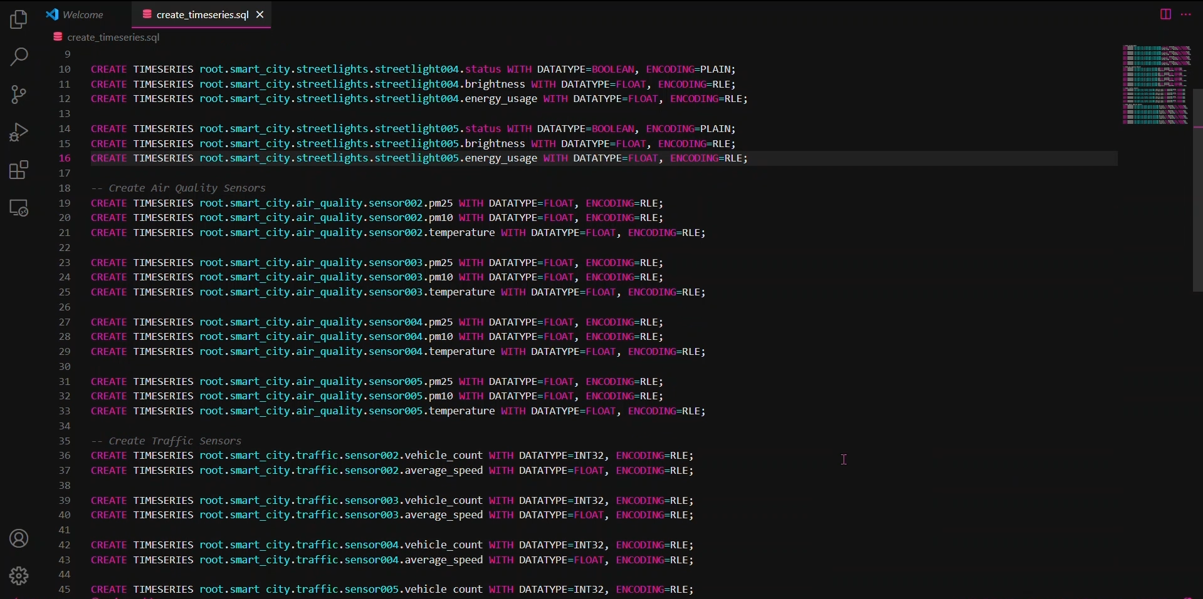

Slide 22
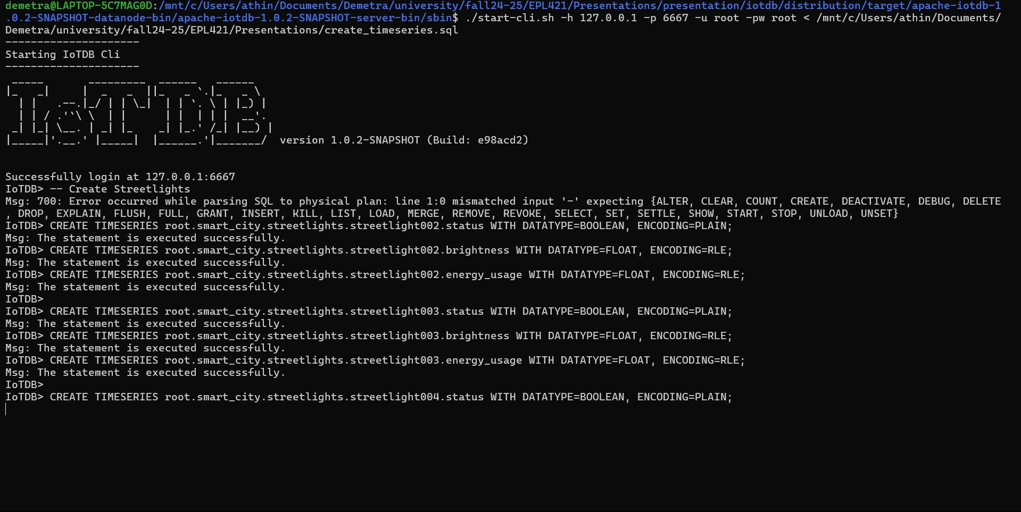

Slide 23
INSERT command
Each time data is inserted to an entity, the timestamp is saved. IoTDB is a time-series database.
1. INSERT INTO root.smart_city.streetlight001(timestamp, status, brightness, energy_usage) VALUES(1672531200000, true, 75.0, 1.5);
2. INSERT INTO root.smart_city.streetlight001(timestamp, status, brightness, energy_usage) VALUES(1672531260000, true, 50.0, 1.2);
Similar logic is applied for the other entities as well.

Slide 24
INSERT
-- Streetlights
INSERT INTO root.smart_city.streetlights.streetlight001(timestamp, status, brightness, energy_usage)
VALUES(1672531200000, true, 80.0, 1.6);
INSERT INTO root.smart_city.streetlights.streetlight001(timestamp, status, brightness, energy_usage)
VALUES(1672531260000, false, 0.0, 0.0);
-- Air Quality Sensors
INSERT INTO root.smart_city.air_quality.sensor001(timestamp, pm25, pm10, temperature)
VALUES(1672531200000, 45.0, 75.0, 25.5);
INSERT INTO root.smart_city.air_quality.sensor001(timestamp, pm25, pm10, temperature)
VALUES(1672531260000, 120.5, 200.0, 27.0);
-- Traffic Cameras
INSERT INTO root.smart_city.traffic.sensor001(timestamp, vehicle_count, average_speed)
VALUES(1672531200000, 35, 45.0);
INSERT INTO root.smart_city.traffic.sensor001(timestamp, vehicle_count, average_speed)
VALUES(1672531260000, 60, 30.5);
-- Water Quality Sensors
INSERT INTO root.smart_city.water_quality.sensor001(timestamp, pH_level, turbidity, temperature)
VALUES(1672531200000, 7.5, 3.2, 20.0);
INSERT INTO root.smart_city.water_quality.sensor001(timestamp, pH_level, turbidity, temperature)
VALUES(1672531260000, 8.1, 5.0, 21.5);

Slide 25
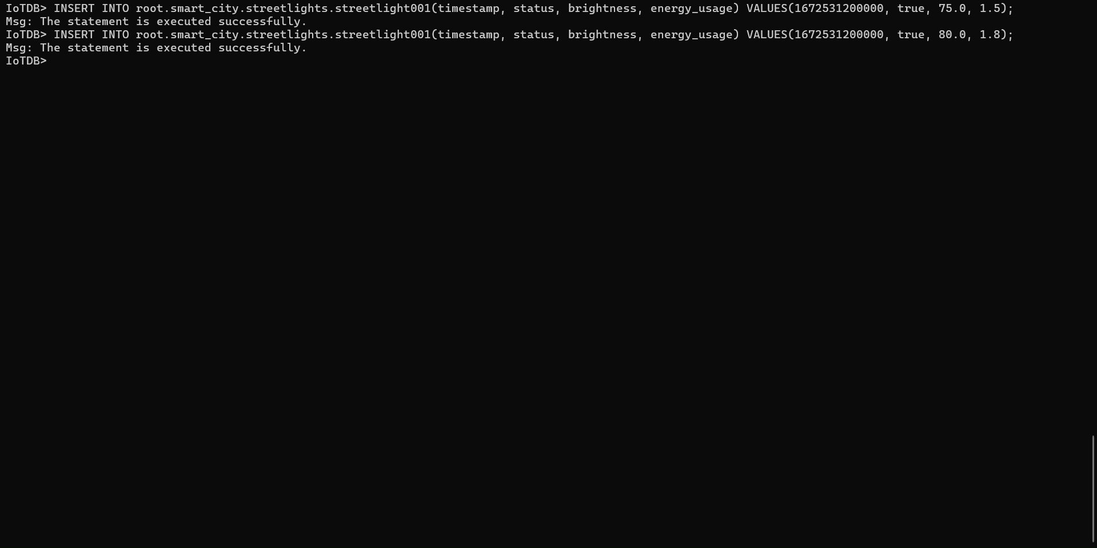

Slide 26
Bulk INSERT
# Insert streetlight data
for i in range(1, 4):
data = generate_streetlight_data()
session.insert_record(
f"root.smart_city.streetlights.streetlight00{i}",
timestamp,
["status", "brightness", "energy_usage"],
[data["status"], data["brightness"], data["energy_usage"]],
)
# Print confirmation and wait for the next round
print(f"Inserted data at {timestamp}")
time.sleep(1) # Wait 1 second before the next round
exceptKeyboardInterrupt:
print("Data insertion stopped.")
finally:
session.close()
import random
import timefrom iotdb.Session
import Session
# Connect to IoTDB
session = Session("127.0.0.1", 6667, "root", "root")
session.open(False)
# Helper functions to generate random data
def generate_streetlight_data():
return {
"status": random.choice([True, False]),
"brightness": round(random.uniform(20, 100), 2),
“energy_usage": round(random.uniform(0.5, 2.5), 2),
}
# Insert data for multiple entitiestry:
for _ in range(10): # Simulate 10 rounds of data insertion
timestamp = int(time.time() * 1000)

Slide 27
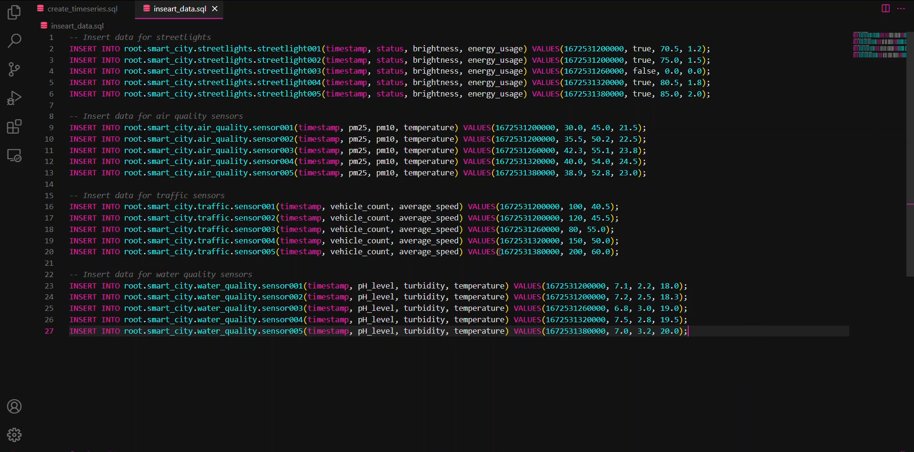

Slide 28
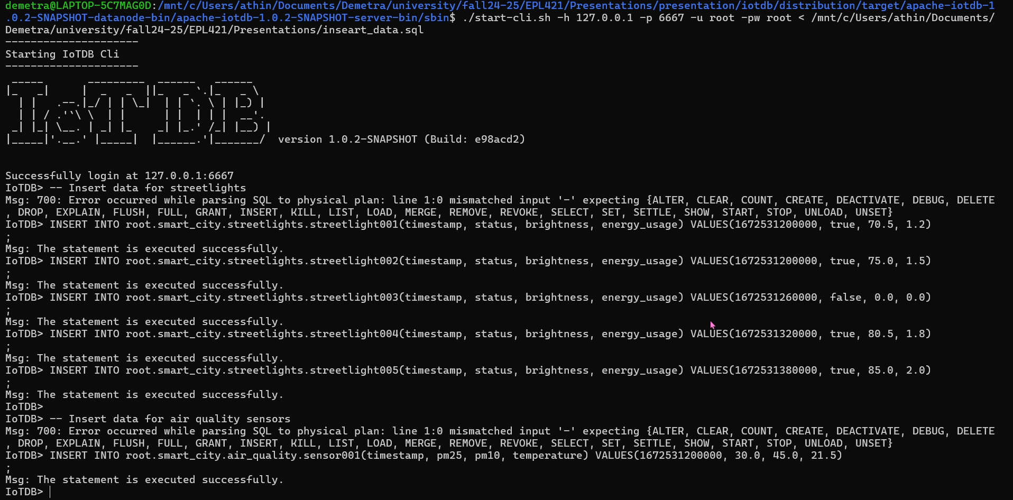

Slide 29
Basic Queries
The queries are very similar to SQL.
Show all timeseries in the database
SHOW TIMESERIES root.smart_city.*;
Data from the water sensors
SELECT * FROM root.smart_city.water_quality.*;
Air Quality data from sensor
SELECT pm25, pm10, temperature FROM root.smart_city.air_quality.sensor001;

Slide 30
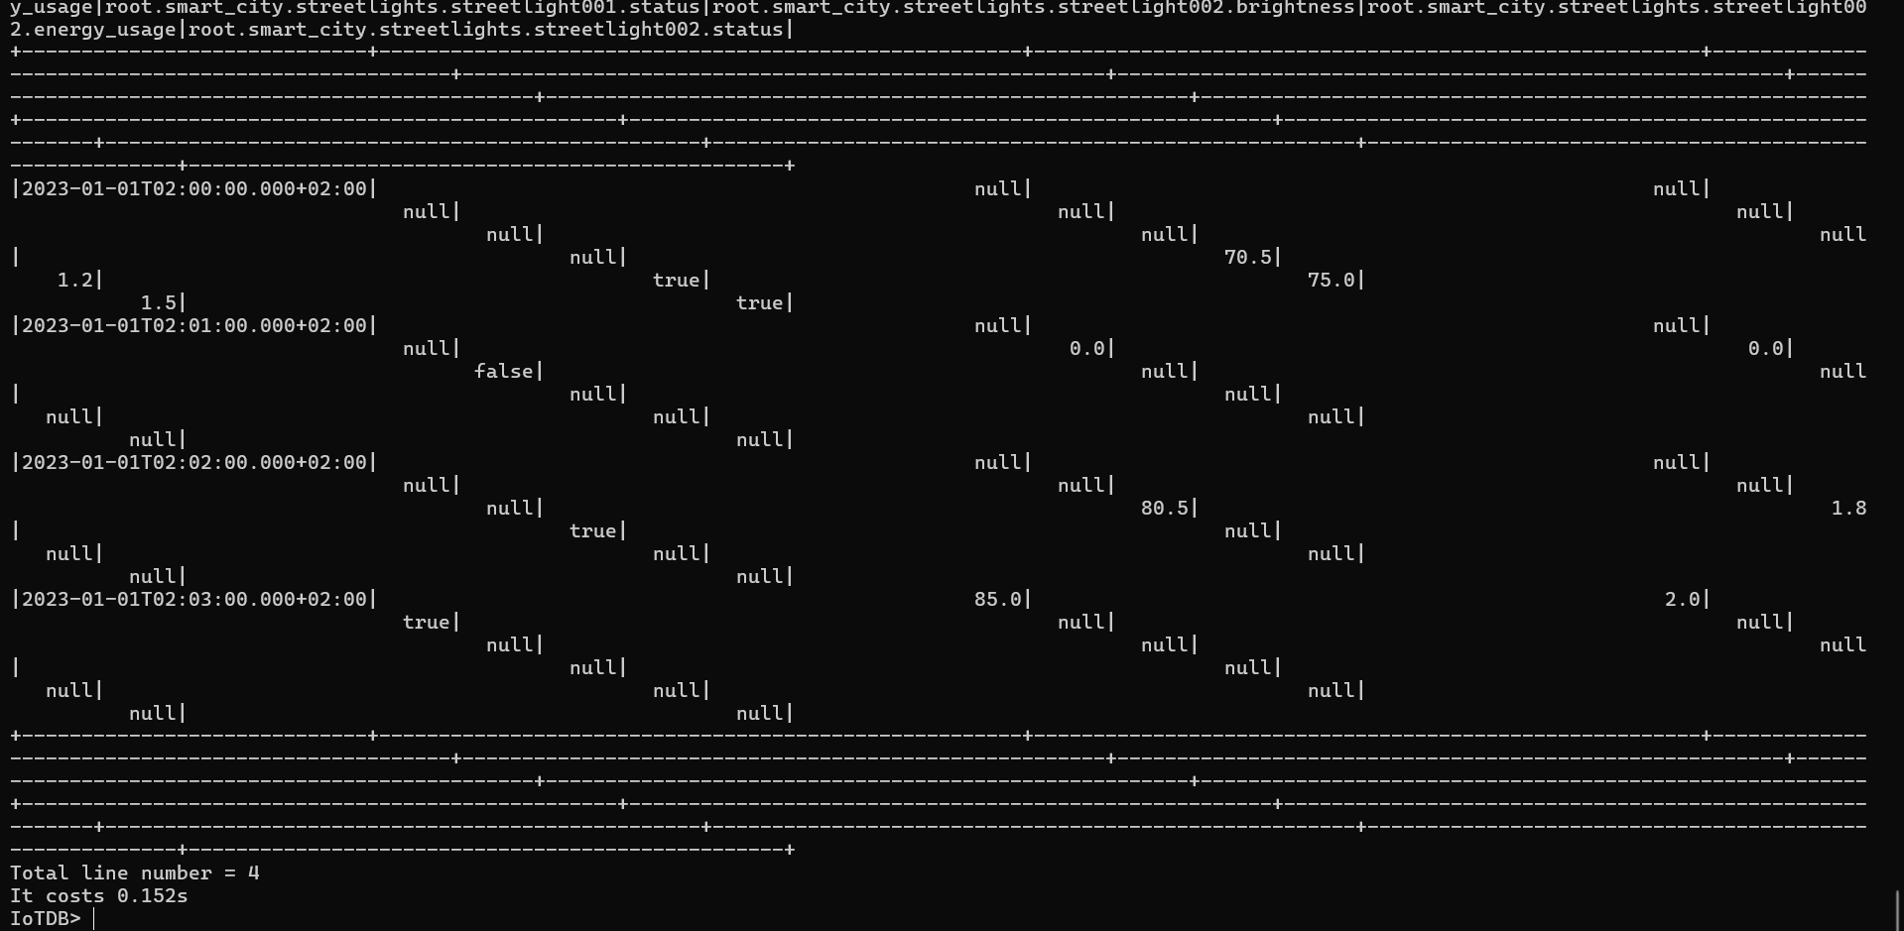

Slide 32
Aggregation Queries
Average brightness of streetlights
SELECT AVG(brightness) FROM root.smart_city.streetlights.*;
Maximum average speed of cars
SELECT MAX_VALUE(average_speed) FROM root.smart_city.traffic.*;
Sum of vehicles in the past hour
SELECT SUM(vehicle_count) FROM root.smart_city.traffic.*
WHERE time > now() - 1h;

Slide 33
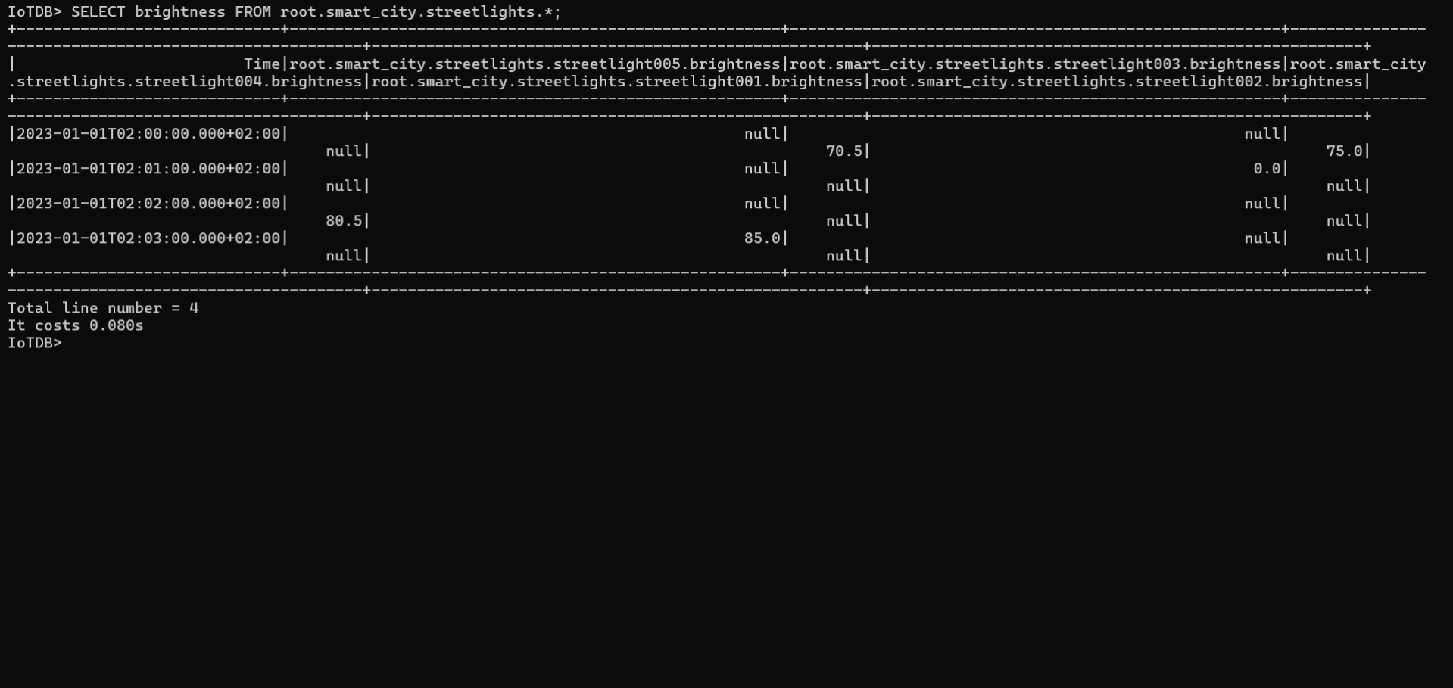

Slide 34
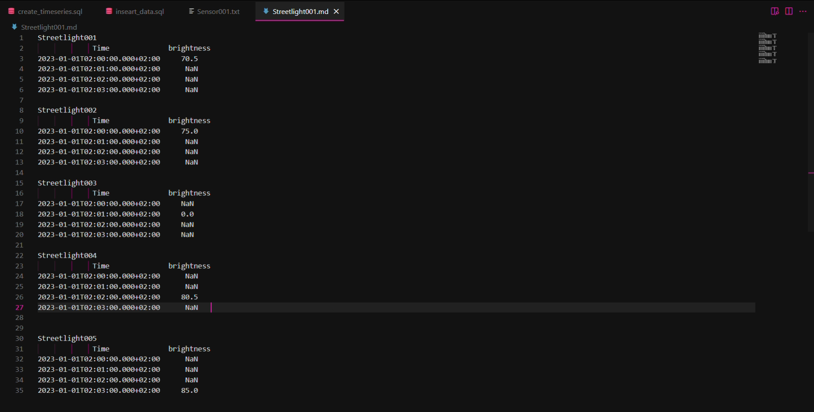

Slide 36
Time Alignment Queries
These type of queries help us detect trends between attributes.
Traffic – Air pollution
SELECT pm25, vehicle_count FROM root.smart_city.air_quality.sensor001, root.smart_city.traffic.sensor001
ALIGN BY TIME;
Streetlight brightness – Energy Usage
SELECT brightness, energy_usage FROM root.smart_city.streetlights.streetlight001
ALIGN BY TIME;

Slide 37
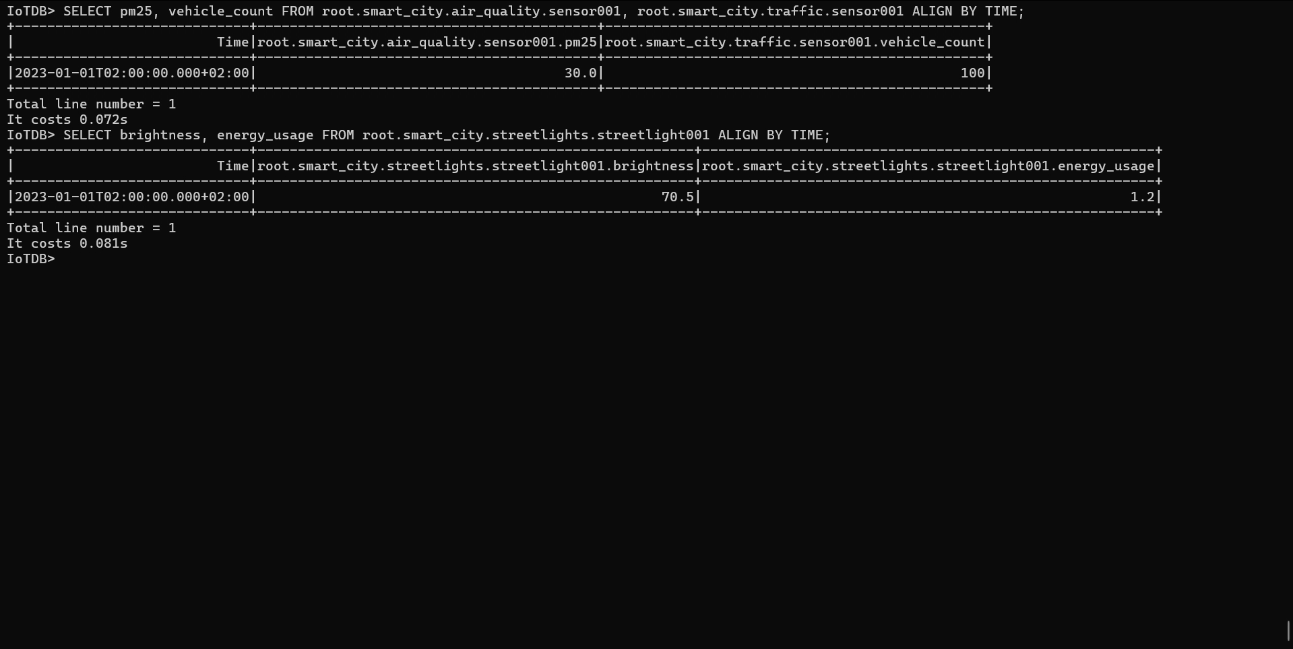

Slide 38
Database Management
Allows administrators to manage access using users and roles.
Only root can modify this
User Management:
Creating users
Deleting users
Altering passwords
Role Management:
Creating roles
Assigning roles to users
Removing roles
Privilege Management
Granting and revoking privileges to/from users and roles
Listing Information
Listing users, roles, and their privileges

Slide 39
Database Management
In the scenario, let’s create a technician that can modify data.
CREATE USER technician 'techpassword'; -- Add a new user
CREATE ROLE data_editor; -- Add a new role
GRANT data_editor TO technician; -- Assign role to the user
GRANT ROLE data_editor PRIVILEGES INSERT_TIMESERIES ON root.smart_city.air_quality; -- Allow data editing on air quality data

Slide 41
User login
Let’s create a user that can only view traffic data, and login.
-- Create a viewer user and a role
CREATE USER viewer_user 'password123';
CREATE ROLE viewer;
-- Grant read-only privileges to the role on traffic data
GRANT ROLE viewer PRIVILEGES READ_TIMESERIES ON root.smart_city.traffic;
-- Assign the role to the user
GRANT viewer TO viewer_user;
To login run: ./sbin/start-cli.sh -h 127.0.0.1 -p 6667 -u viewer_user -pw password123

Slide 42
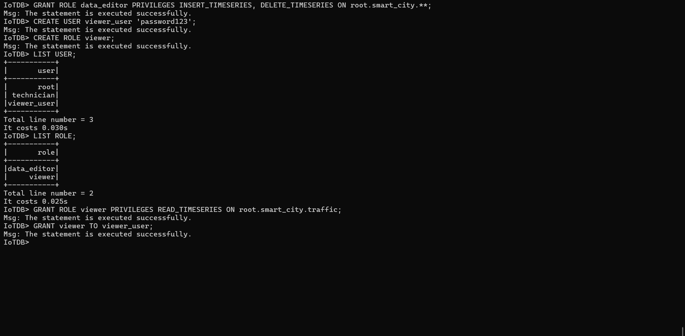

Slide 44
Functions
Find first and last recorded pm values
SELECT FIRST_VALUE(pm25), LAST_VALUE(pm25) FROM root.smart_city.air_quality.*;
Find min and max across all streetlights
SELECT MAX_VALUE(energy_usage), MIN_VALUE(energy_usage)
FROM root.smart_city.streetlights.**
GROUP BY LEVEL=2;

Slide 45
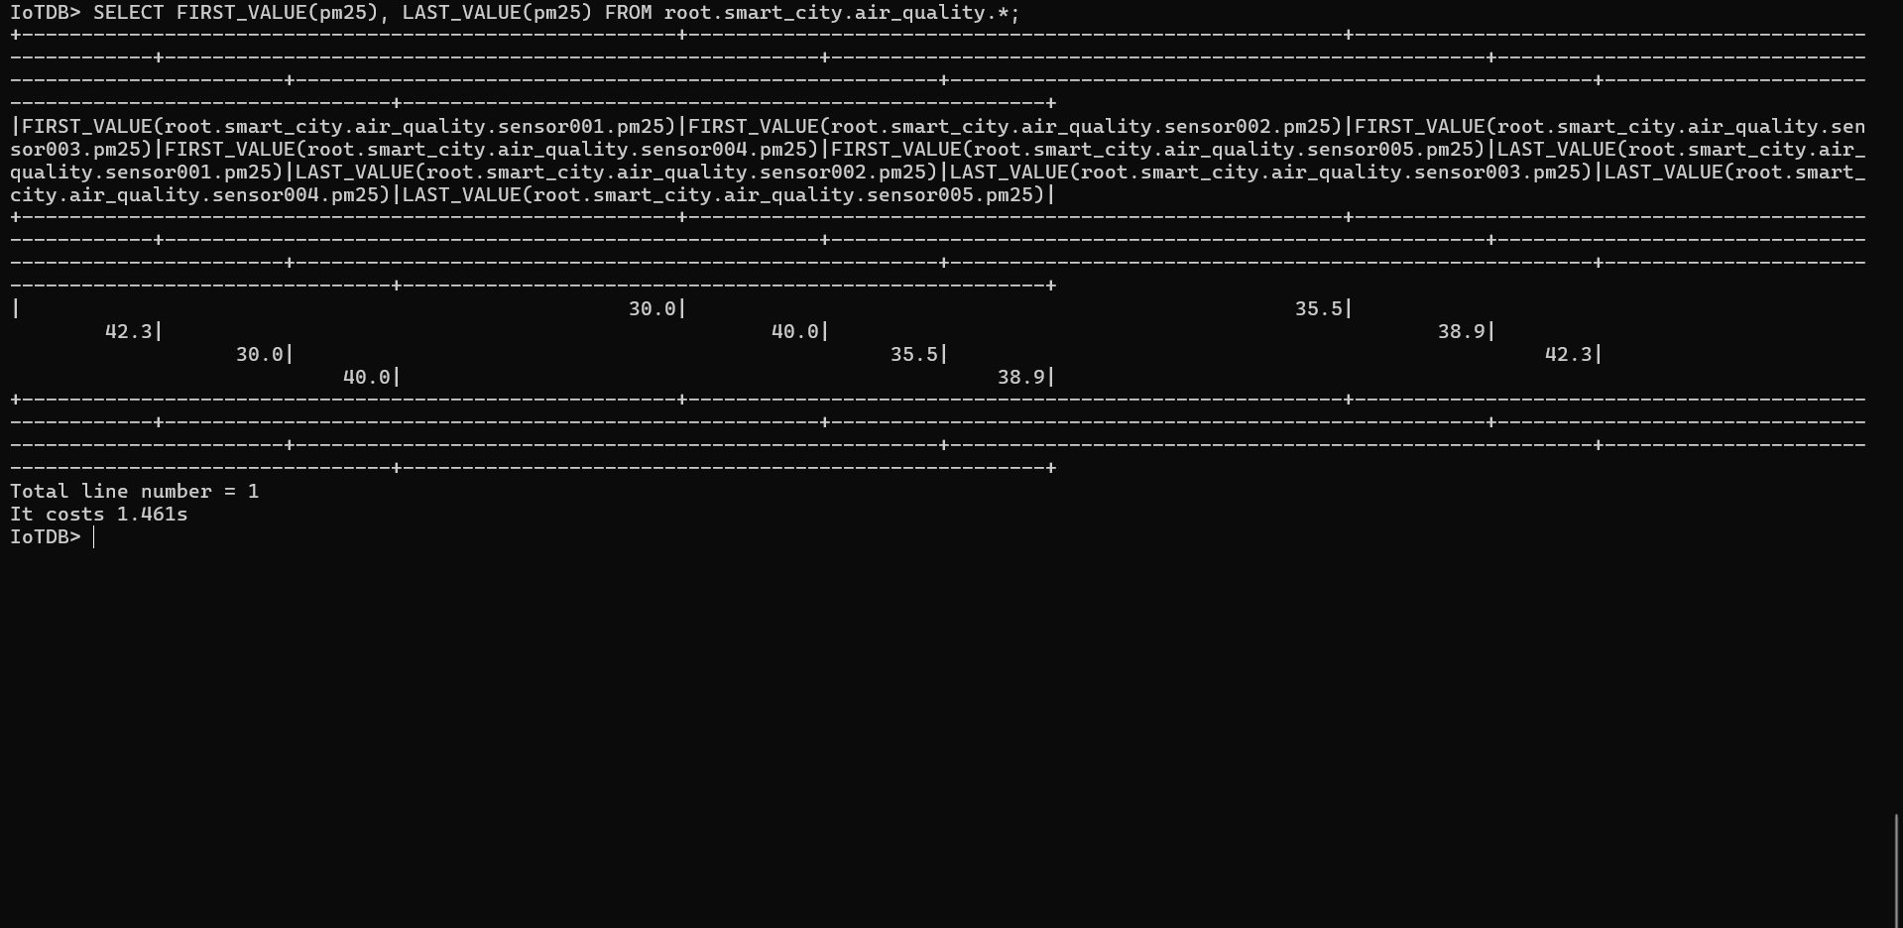

Slide 47
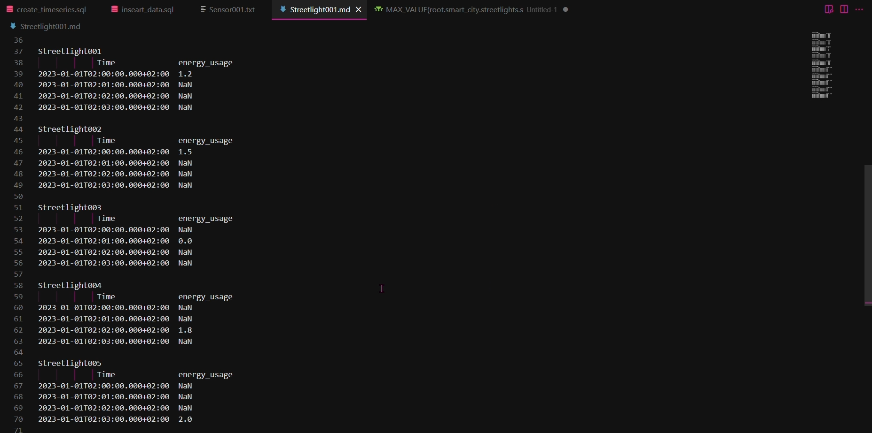

Slide 48
IoTDB Advanced Features Overview
Storage-Level TTL
Automatically deletes old data to optimize performance and save disk space.
Example: SET TTL TO root.group1 3600000 (Keeps only the last hour of data)
Manage TTL with SET TTL, UNSET TTL, and SHOW TTL.
Kill Queries
View running queries: SHOW QUERY PROCESSLIST
Terminate specific queries using KILL QUERY <QueryID>
System Modes
Switch between read-only and writable modes
Example: SET SYSTEM TO READONLY

Slide 49
Conclusion
IoTDB is easy to create, insert, and manage data.
The syntax is very similar to SQL
Real-time monitoring and analytics.

Slide 50
Sources
https://www.ibm.com/topics/internet-of-things
https://iotdb.apache.org/
https://iotdb.apache.org/UserGuide/V1.0.x/Reference/SQL-Reference.html
https://cratedb.com/

